Slide 1
What Is a Prompt?
Why need Prompt engineering ?
GEN AIs Project and Prompt engineering ?

Slide 2
One of the significant capabilities of generative AI models is that their output closely resembles what a human can produce. Relevant, contextual, imaginative, nuanced, and linguistically accurate and one of the critical factors in generating this output is prompt.
What is a prompt? A prompt is any input you provide to a generative model to produce a desired output.
You can think of it as an instruction you provide to the model.
For example, write a small paragraph describing your favorite holiday destination.
Write HTML code to generate a dropdown selection of cities within an online form.
These are straightforward prompts used to produce a specific output. Prompts can also be a series of instructions that refine the output step by step to achieve the desired result.
For example, write a short story about a scientist studying life on Mars. What were some of the challenges he faced during his research?
With these examples, it is clear that prompts contain questions, contextual text, guiding patterns or examples, and partial input for the model.
Based on these natural language requests submitted as prompts, generative AI models collect information, derive inferences, and provide creative solutions.
These instructions help the model produce relevant and logical responses or output based on provided inputs. Let's look at some more examples to help us understand this better.
Suppose you want the model to write a short story about the struggles and achievements of a farmer who became a successful businessman in 10 years. If your prompt is rich man's story from a small town, his struggles and achievements, it'll produce a generic output.
As this is what we call naive prompting.

Slide 3
It means asking queries from the model in the simplest possible manner. To convey your intentions to the model, you can make simple adjustments that can radically improve the result.
Like your prompt must have context to proper structure and can be comprehensible so you can rewrite the prompt as
"Write a short story about the struggles and achievements of a farmer who became a rich and influential businessman in 10 years."
Let's look at another example where you want the model to generate an image of a sunset scenery you have in mind.
Writing the prompt as "Sunset image between mountains" may not give you the desired output. The prompt is too brief and lacks a detailed outline of the image you have in mind. You can rewrite the prompt as "Generate an image depicting a calm sunset about a river valley that rests amidst the mountains."

Slide 4
To master the art of writing effective prompts, let's understand the building blocks of a well constructed prompt one by one. Instructions, give the model distinct guidelines regarding the task you wish to execute.
Steering the actions of the generative AI model to influence the formation of its response. Like "Write an essay in 600 words, analyzing the effects of global warming on marine life" is one example. Context, helps establish the circumstances that form the setting of the instruction and provides a framework for generating relevant content.
To understand this, let's add some context to the prompt discussed in the previous example. "In recent decades, global warming has undergone significant shifts, leading to rising sea levels, increased storm intensity, and changing weather patterns.
These changes have had a severe impact on marine life. Write an essay in 600 words analyzing the effects of global warming on marine life." This prompt will help the model generate output aligned with the context. Input data is any piece of information provided by you as part of the prompt. This can be used as a reference for the generative model to attain responses with a specific set of details or ideas. To provide input data, the same prompt can be reconstructed in the following manner. "You have been provided with a data set containing temperature records and measurements of sea levels in the Pacific Ocean.
Write essay in 600 words, analyzing the effects of global warming on marine life in the Pacific Ocean." Output indicator, offers benchmarks for assessing the attributes of the output generated by the model. It can outline the tone, style, length, and other qualities you desire from the output.
In the prompt "Write an essay in 600 words, analyzing the effects of global warming on marine life," the output indicator specifies that the output generated should be an essay of 600 words. It will be evaluated based on the clarity of the analysis and the incorporation of relevant data or case studies. Each of these elements plays a role in helping the generative AI model comprehend your requirements and give you the desired output.
Here, you learned that a prompt is any input or series of instructions you provide to a generative model to produce a desired output.
These instructions help in directing the creativity of the model and assist it in producing relevant and logical responses. The building blocks of a well structured prompt include instruction, context, input data, and output indicators. These elements help the model comprehend our necessities and generate relevant responses.

Slide 5
Prompt Engineering ?
The process of designing effective prompts to generate better and desired responses is called prompt engineering. Although generative AI models have the potential to supplement human creativity, if you fail to provide precise prompts, these models may produce inadequate results and even false and misleading information. Prompt engineering is a blend of critical analysis, creativity, and technical acumen. It is not limited to asking the right question.
It includes framing the question in the right context with the right information and your expectation of desired outcomes to elicit the most appropriate response. Let's understand this through an example.
A ship is sailing through the Atlantic Ocean. To plan his voyage, the ship's captain wants to know the precise weather forecast for a specific location at a specific time. In this case, providing the model with a simple prompt, such as weather forecast of the Atlantic Ocean, may not get the desired results. To get the most accurate results, the captain will have to engineer the prompts. When designing the prompt, the captain needs to define the context to include details such as the intended location for the weather forecast in latitude and longitude and the time range for prediction.

Slide 6
For example, the captain of a ship is planning a strategic voyage in the Atlantic Ocean. To help the captain navigate effectively, provide weather forecasts for the upcoming week from 28th August 2023 to 1st September 2023. The coordinates of the target location are between 20 degrees north and 30 degrees north latitude and 40 degrees west and 20 degrees west longitude. The captain must also indicate whether he requires specific output, like should the model return information on other weather elements that could affect the voyage.
For example, to help plan an effective navigation in the Atlantic Ocean, provide detailed information about expected wind patterns, wave heights, precipitation probabilities, cloud cover, and any potential storms that might affect the voyage during a specified time frame and location.
It's important to recognize that prompt engineering is a well-structured iterative process that involves refining the prompts and experimenting with various factors that could influence the output from the model.

Slide 7
Prompt engineering and Problem solving
Let's understand the step-by-step process involved in creating effective prompts through prompt engineering.
Define the goal : The initial step in the process involves establishing a distinct goal. You must know what exactly you want the model to generate. For example, form a brief overview of the benefits and risks associated with artificial intelligence and automobiles.
Craft initial prompt : Having defined the goal, it's now time to create an initial prompt. This might manifest as a question, a directive, or even a situation depending on the goal. For example, write an article that presents a well-rounded analysis of the benefits and drawbacks associated with the incorporation of artificial intelligence in the field of automobile industry.
Test the prompt : The prompt you created should now be tested and analyzed for its response. While the response might be relevant, it could lack the distinct perspective you are aiming for. For example, the response to the initial prompt directly lays out the benefits and drawbacks of integrating artificial intelligence in the automobile industry. It does not highlight any ethical concerns that might arise. Further, there's no discussion on the positive and negative implications of the scene.
Analyze the response, you must carefully review the response and examine whether it aligns with your goals. If not, make a note of the areas where it fell short.For example, the initial prompt used fails to cover a comprehensive range of benefits and risks associated with artificial intelligence in the automobile industry.
Refine the prompt: Using the knowledge acquired through testing and analysis, it's now appropriate to modify the prompt. This might include enhancing its specificity, incorporating additional context, or rephrasing.

Slide 8
Write an informative article discussing the role of artificial intelligence in revolutionizing the automobile industry. Cover specific domains like autonomous driving and real-time traffic analysis, while also examining potential challenges such as technical complexity and cybersecurity concerns. Address key aspects such as benefits, drawbacks, ethical considerations, and both positive and negative implications. The initial prompt can be refined as follows. Iterate the process. The last three steps are repeated until you're satisfied with the response.
Consequently, following several cycles of refinement, the final prompt shall take this form : Write an article highlighting how artificial intelligence is reshaping the automobile industry focusing on the positive advancements, particularly in autonomous driving and real-time traffic analysis, while thoroughly exploring concerns related to intricate technical aspects such as decision-making algorithms and potential cybersecurity breaches. Emphasize the implications these concerns may have on vehicle safety. Ensure that the analysis is thorough, backed with examples, and encourages critical thinking.
Now let's summarize the importance and relevance of prompt engineering and generative AI models.
Optimizing model efficiency : Prompt engineering helps design intelligent prompts that allow the users to harness the full capabilities of these models without requiring extensive retraining. Boosting performance for specific tasks. Prompt engineering empowers generative AI models to deliver responses that are nuanced and have a context, rendering them more effective for specific tasks. Understanding model constraints. Refining prompts through each iteration and studying the corresponding responses of the model can help us understand its strengths and weaknesses.
This knowledge can further guide feature enhancement or complete development of the model in the future. Enhancing model security. Skilled prompt engineering can prevent issues of harmful content generation due to poorly designed prompts, thereby enhancing safe utilization of the model.
You learned that prompt engineering is the process of designing effective prompts to leverage the full capabilities of generative AI models and producing optimal responses. You also learned the process of refining a prompt via prompt engineering. At last, you learned the importance of prompt engineering and optimizing model efficiency, boosting performance, understanding model constraints, and enhancing its security.

Slide 9
To solve Prompt Engineering Problems
Identify key components of the Generative AI lab interface, including chat history, prompt area, and model selection options.
Demonstrate how to perform basic actions such as renaming or deleting a chat and entering prompt instructions.
Explore the model response behavior by running simple prompts and observing the output within the interface.
Prompt Structure
Prompts in different formats
Limit the Input and output length

Slide 10
Steps to solve Prompt Engineering Problems :
Large language models (LLMs) are pre-trained on vast amounts of data to generate novel content, including text, images, and video. To generate the desired response, you should feed the input to a model as a prompt. It is important to provide a context-based, clear, and precise prompt to guide the model and get the desired output. The process of designing effective prompts to generate better and desired responses is called prompt engineering.
Design a prompt structure to write concise prompts based on requirements.Write unambiguous and context-based prompts to generate the desired output. Write prompts in different formats, such as questions, statements, and instructions. Before solving the problem , you must set up the AI and know the generative AI workspace.
Steps in order :
Name the chat , Choose the foundation model, Know your workspace to prompt the foundation model-based chatbot better. Use prompt instructions, Type your message, Manage your chat, Delete the chat from history, Identify the task to be accomplished through a prompt, Before you draft a prompt, you should clearly understand the task that a model needs to perform.
For example, do you want the model to generate a story or a social post, or do you want the model to summarize text or classify text by identifying sentiments? Select the model
Before you start designing prompts, it is important to understand the model you will leverage to accomplish the tasks.
OpenAI's GPT-5 Nano is an advanced foundation large language model. As a powerful tool for generating coherent and contextually relevant text, the GPT-5 Nano foundation model can be used for various applications, including chatbots, virtual assistants, content generation, and more. It can be applied for translating languages, answering questions in an informative way, and completing tasks such as writing poems, code, scripts, musical pieces, emails, letters, and so on.

Slide 11
Writing effective prompts is crucial for utilizing the full potential of generative AI models to produce relevant and accurate responses. By applying the best practices for creating effective prompts, you can supervise the style, tone, and content of the output generated. You can apply the best practices for crafting effective prompts across four essential dimensions: clarity, context, precision, and role play or persona pattern. Let's explore each of these aspects individually. To have clarity in your prompt, keep the following points in mind.
Simple and straightforward language can convey instructions easily. Write prompts that are unambiguous and easy to comprehend. Specialized terminologies can potentially puzzle the model or the users, so write prompts using simple terms that can be understood by a broad range of audiences. Vague prompts could lead to responses that do not align with your intentions, therefore, you must provide a clear description of the task that the model must perform. Let's understand this through an example. Discuss culinary processes that take place on foliaceous stipules of plants with the help of sunlight, also mention a green thing and how light, air, and water are important for aerial parts of the plant. This prompt has much ambiguity.
Nowhere does it explicitly mention the process you want to discuss. The prompt contains complex terminologies which make it difficult to comprehend. It's also vague and does not clearly describe the task at hand. To ensure clarity, you can rewrite this prompt as, explain the process of photosynthesis in plants, detailing the role of chlorophyll and how sunlight, carbon dioxide, and water contribute to this biological function. The revised prompt has simple, clear, and concise language and explicitly states that you want to discuss the process of photosynthesis in plants. Moving on to the next essential dimension, which is the context. Context always helps the model understand the situation or the subject.

Slide 12
This could involve giving a brief introduction or explanation of the circumstances in which the response is required, relevant information or specific details like people, places, events, or concepts help guide the understanding of the model. It's important to incorporate such details while writing prompts. For example, the prompt, write what happened during the outbreak of the Revolutionary War in 1775 does not contain adequate context and specific details to guide the understanding of the model. To establish the right context and include the relevant information, you can rewrite this prompt as, describe the historical events leading to the American Revolutionary War, focusing on key incidents like the Boston Tea Party, Battle of Saratoga and so on. Highlight the tensions between the American colonies and the British government and explain how these events led to the outbreak of the Revolutionary War in 1775. Another important dimension for creating effective prompts is precision. Precision helps outline your request in the prompt.
If you're searching for a particular kind of response, express that with clarity.
Examples incorporated within your prompts can help the model understand what kind of response you're looking for and direct its thought process. For example, in the prompt talk about supply and demand and how it is affected in economics, there's no precise outline of a particular kind of response and no examples. To ensure precision, you can rewrite this prompt as explain the concept of supply and demand in economics, describe how an increase in demand can influence pricing with the help of an illustrative example like the smartphone market. Similarly, explain the repercussions of reduced supply on pricing by drawing parallels with situations like disruptions in oil production. This prompt clearly expresses that you want to explain a concept with the help of examples. Finally, let's discuss the last dimension, which is role play or persona pattern.

Slide 13
Prompts written from the perspective of a specific character or persona can help the model generate responses aligned with that perspective. Essential contextual details enable the model to effectively assume a particular role. If you're requesting the model to reply from the standpoint of a historical figure, a fictional character or a specific profession, then provide contextual details. Let's look at this example here. Write a log entry describing the strange flora and fauna of an uncharted alien planet. This prompt will simply give scientific details about the alien planet and will not explain its answer from the perspective of a professional. You can rewrite the prompt as pretend you are an astronaut who has just landed on an uncharted alien planet.
Write a log entry describing the strange flora and fauna you've encountered, like the color of the sky and the unfamiliar sounds echoing through the alien landscape. Express your feelings of excitement, curiosity, and a hint of apprehension as you document this extraordinary journey. In this example, you explicitly gave contextual details and assumed yourself to be an astronaut. This prompt will generate a response aligned with the perspective of an astronaut.
You learned that writing effective prompts for generative AI models is essential for supervising the style, tone, and content of the output. Best practices for writing effective prompts can be implemented across four dimensions: clarity, context, precision, and role play. Clarity includes using simple and concise language, context provides background and required details, precision means being specific and providing examples.
Role play can enhance responses by assuming a persona and offering relevant context. These practices can be adapted to specific needs for optimal results.

Slide 14
Chain of thought : Significantly bolsters the cognitive performance of AI models by segmenting complex tasks into more manageable steps. By adopting this prompting strategy, AI models can demonstrate heightened cognitive abilities and offer a deeper understanding of their reasoning processes. This approach is an example of prompt-based learning, and it requires feeding the model with questions and their corresponding solutions before posing related subsequent questions to it. In other words, our CoT prompt teaches the model to reason about the problem and mimic the same reasoning to respond to further queries correctly. Chain of thought : ​Phrases such as, let's think step-by-step or let's work this out step-by-step to ensure ​we have the right answer are added to the prompt to help the system devise methods to solve ​the problem independently. ​Let's take the same pen case problem and see how it is solved using the Zero-Shot method. ​The prompt is given as follows. ​If a store sells pen cases on a buy-one-get-one-free offer, and each pen case costs $5, how much ​would 10 pen cases cost? ​Let's think step-by-step. ​In this case, the system doesn't rely on a sample or example beforehand. ​Instead, it tries to reason through the problem on its own.
The tree-of-thought approach : Enhances AI reasoning by structuring prompts like a tree with hierarchical ​branches representing different lines of thought. ​It allows the AI to evaluate multiple possibilities simultaneously, assess potential outcomes, ​and focus on the most promising options. ​This technique is valuable for solving complex problems by offering explicit guidance and ​exploring various solutions. ​
Tree of thought : The prompt is, our online store has seen a 20% drop in sales over the past three months ​despite steady website traffic. ​What could be causing this and how should we approach fixing it? ​Think of three possible reasons and try to approach the solution from multiple directions ​giving a single structured plan of action. ​As a response to the prompt, the model begins by identifying and clearly outlining the three ​most likely causes of the sales decline, poor conversion rate, product or pricing issues, ​or external market factors. ​It then proposes a multi-directional approach to fixing the targeted issue where a strategy ​is developed for each of the principal reasons identified. ​Finally, the model presents a structured implementation plan addressing the issue across ​short-term, medium-term, and long-term actions. ​

Slide 15
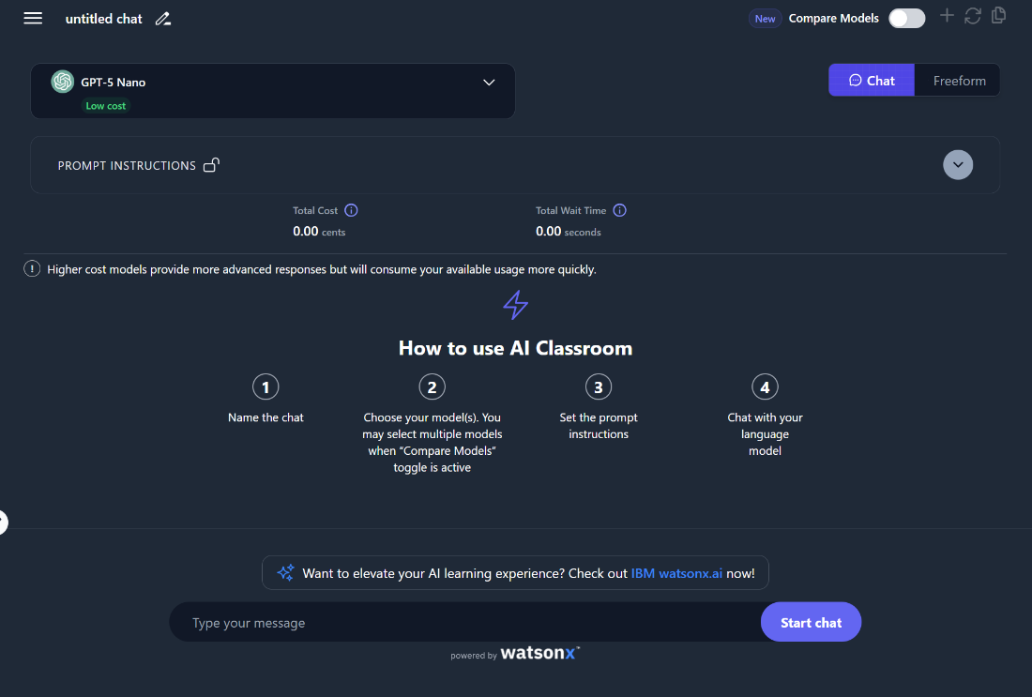
Interview Pattern approach
This approach requires meticulous optimization of the prompt to ​ensure the model generates responses that precisely meet your objectives. ​It involves providing specific prompt instructions to the model in response to ​which the model asks necessary follow-up questions from the user. ​Depending on the response to these follow-up questions, ​the model draws information relevant to its task, processes it, and ​provides a well optimized response to the user.
Naïve : We'll query AI in the simplest way possible, like most people would. The result will be alright, but we'll see how a simple adjustment can radically improve the results later in the lab.
Persona : The persona pattern in prompt engineering instructs a Large Language Model (LLM) to "act as" a specific character, professional, or persona to tailor its tone, style, and expertise to a task.

Slide 16

The Playoff Method
This is a strategy used to compare responses generated from multiple prompts.
The idea is to generate several different prompts for a given task, then compare the responses from each prompt through a pairwise comparison to determine which prompt results in the best output.

Slide 17

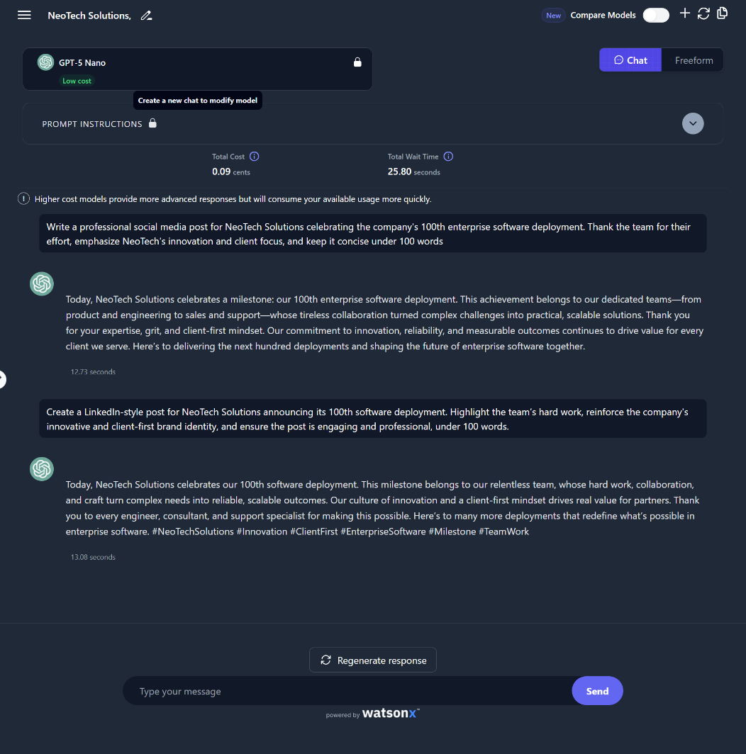












Slide 18

Multimodal prompts :
Summarize multimodal content from a PDF document using generative AI
Analyze and extract key data points from an image using multimodal prompt techniques :
Generate a creative narrative or description inspired by a visual image
Multimodal prompts is one of the key advancements in the constantly evolving field of AI. It enables generative AI (GenAI) models to leverage content from different modalities (such as text and images) and provide a more robust, more structured response to the user queries.
You will make use of publicly available GenAI tools like OpenAI's ChatGPT and Google's Gemini to explore how these tools interpret and respond to multimodal inputs. You will experiment with combining text and images in your prompts to observe how each tool handles contextual understanding, reasoning, and creativity across different modalities.

Slide 19
Multimodal Prompts
Task 1: Multimodal PDF content analysis:
You are part of a research team analyzing how GenAI is being adopted in everyday tasks. Your team has received a PDF survey report titled "Adoption of GenAI in Day-to-Day Tasks," which includes a mix of text, tables, and charts.
In this task, you will use a multimodal GenAI model to extract insights from both the textual and visual elements of the document. Your goal is to understand how well the model interprets complex, multimodal content and to evaluate its ability to summarize findings, identify trends, and answer specific questions based on the PDF.
Sample prompt to summarize the multimodal document :
Briefly Summarize the key findings of this PDF survey, including both the text and any visual data like charts or tables.
What are the most common day-to-day tasks where users report adopting GenAI, based on the content of this document?

Slide 20

Multimodal Prompts
Task 2: Image analysis :
Scenario: Personal expense tracking
You are part of a consumer analytics team for a grocery chain. You've been given the receipt (as an image) from a customer's purchase at Fresh Foods Market. Your goal is to extract insights from the receipt to support various business and customer service objectives, such as inventory planning, price comparison, tax calculations, and trend analysis.
Sample prompt to extract data from the image : Extract the list of all items purchased, including quantities, unit prices, and total prices.
Sample prompt for conducting mathematical reasoning to calculate the average price per item category : Calculate the average price per item category (produce, dairy, meat, pantry).
Sample prompt for decision-making and optimization: A prompt to analyze the purchased items and suggest which could be omitted or replaced with cheaper alternatives to stay within budget (of $80).
Imagine this shopper had a strict budget of $80 for this trip. Based on the items purchased, which items, if any, could they have potentially omitted or swapped for cheaper alternatives to stay within budget, while still acquiring a reasonable variety of groceries? Justify your suggestions.

Slide 21

Multimodal Prompts
Task 3: Creative content generation
Scenario: You are a content designer for an immersive narrative app that generates personalized creative content based on photos users upload. Your task is to develop a written piece, inspired by a mysterious image sent by a user — a serene alpine landscape at sunset, with a small cabin, a glowing campfire, and four people gathered around it.
Sample prompt to generate a short story :
Write a short story inspired by this image . Focus on the people around the campfire and what brings them to this remote location at sunset.
Generate a poem or a lyrical piece that captures the mood and beauty of this landscape at dusk, reflecting on themes of nature, connection, or tranquility.
By using multimodal prompts, you experienced firsthand how AI can interpret visual content, extract information from integrated text and images, and generate creative responses that draw upon both seeing and reading. This capability reflects GenAI's growing ability to interact with data in ways that are closer to human perception, opening up possibilities for richer analysis, more intuitive information retrieval, and innovative content creation from diverse sources.

